Slide 1
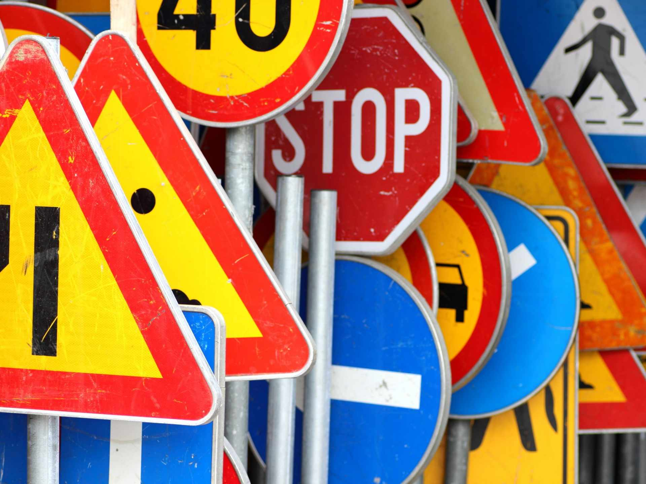
road sign recognition
Santello Veronica 870320

Slide 2

GOAL
The goal of this project is to test two different image recognition algorithms and evaluate the strengths and weaknesses of each.

Slide 3
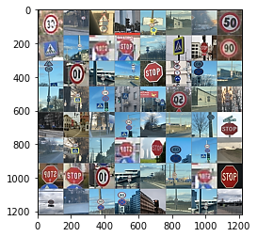
Training set images

Slide 4

Convolutional Neural Network

Slide 5
My c-nn
Data reading and preprocessing
CNN network using different layers
Traning CNN with our dataset and saving best model based on testing accuracy

Slide 6
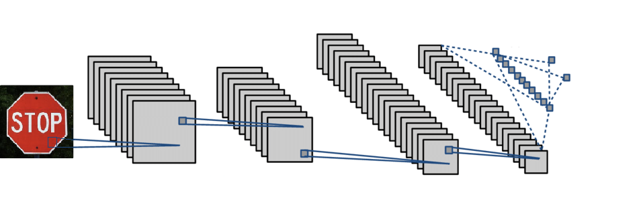
My c-nn

Slide 7
My c-nn
3 convolution levels
kernel_size=3,stride=1,padding=1
Relu to bring no linearity
Max pooling x ridurre image

Slide 8
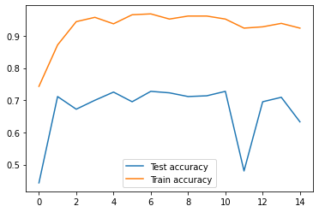
COMPARISONS BETWEEN TEST AND TRAIN ACCURACY

